Slide 2
View showing impact of new street prior to redevelopment

Slide 3
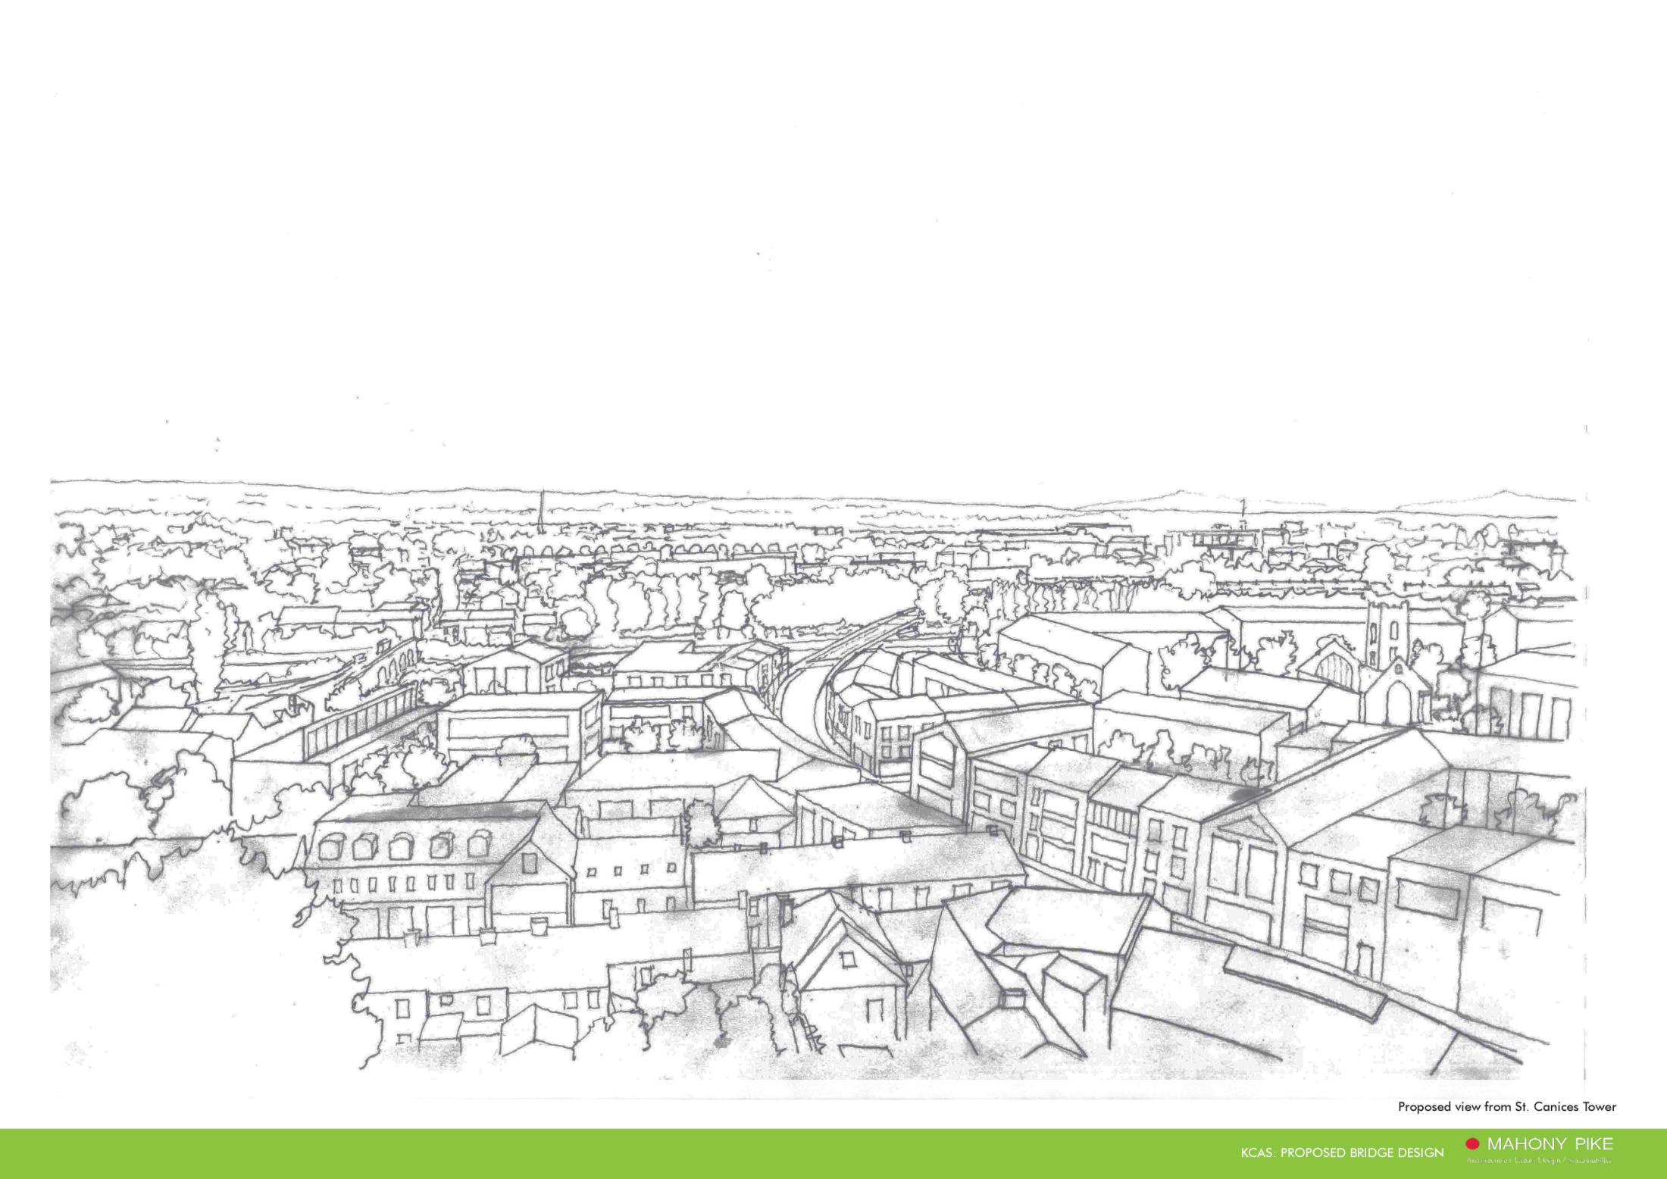
Sketch View of Potential Development

Slide 4
View showing undeveloped site

Slide 5
Sketch of potential riverside development

Slide 10
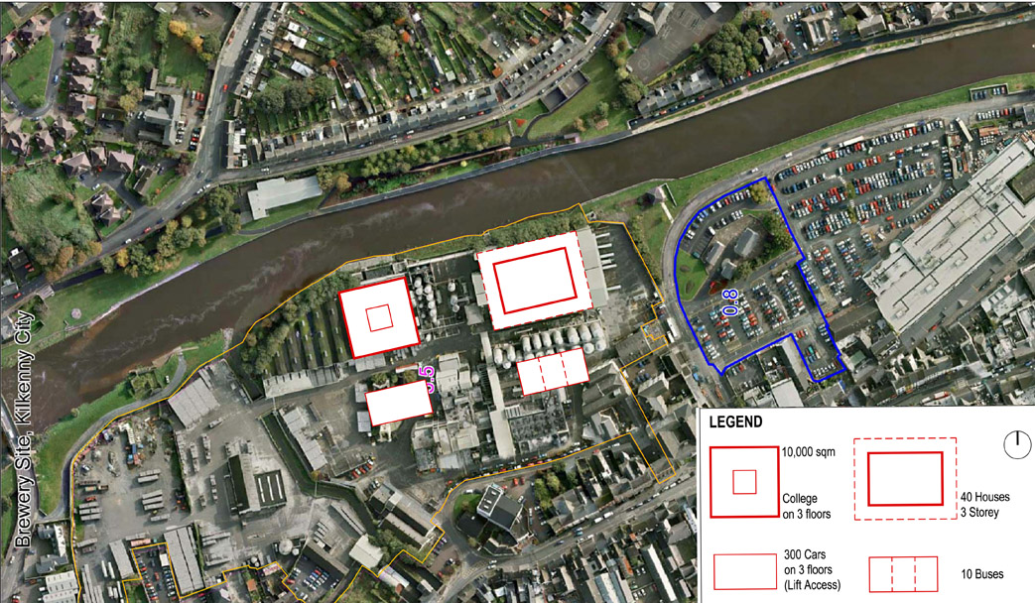
Diagram showing areas required for specific uses

Slide 11
Potential uses.
Diageo site and Mart site to be considered together.
Third level institute—Diageo. Student housing and facilities—Mart.
Other residential— Retired could be attracted to Kilkenny centre and riverside.
Other small households need good facilities
Open space and recreation—Need for more in city centre. Potential for riverside,
Mouth of Bregagh and Friary.
Shopping—Supermarket chains now changing policy to smaller local stores.
Could be favourable to Diageo site—regeneration of Dunnes site.
Industries/ business—Third level institute an attraction. Also film and media.
Parking—Additional parking to feed from Central access street, and buses.
Maximise potential of Mart site.

